Slide 1
VEEVA Medical Inquiries

Slide 2
About the Author
Created By: | Subham Chowdhury, Arpita Bhattacharya, Supriyo Saha
Credential Information: | Associate – Projects, Sr. Consultant CRM – EAS Salesforce
Version and Date: | Version 1, 01-22-2018, V2.0: July-2023:Updated with Lightning UI
Modified By: | Ritesh Kumar Prasad & Srijena,N

Slide 3

Objectives
After completing this chapter, you will be able to:
  Describe Medical Inquiries life cycle
  Define the components of Medical Inquiry
  Configure various components of Medical Inquiry module
  Configure Medical Inquiry module for multiple Product inquiries

Slide 4
Recap ...
In the previous Module - Survey Management, you learnt to:
  Describe Survey
  Create new survey
  Describe Survey management
  Describe Survey Data Model
And now ...

Slide 5

Overview
Medical Inquiries are captured by Sales Representatives from Person Accounts
Medical Inquiries can be specific to a Product or can be general inquiries by HCPs
VEEVA Medical Inquiries module allows users to record inquiries, capture and audit signatures
Inquiries can be captured against Health Care Professionals on the Account page or when recording a Call
Electronic form in VEEVA to document off-label request and submit to appropriate channels to fulfill the request

Slide 6

Do You Know
If a Medical Inquiry is associated with a Call, the inquiry is submitted when the Call is submitted
Users can create Medical Inquires in four ways: from an Account Related list, from Account Views, from a Call Report, and from CLM
The default Medical Inquiry module allows users to capture a single inquiry at a time
However, it is possible to capture multiple Medical Inquiries at once, even if they are for different products

Slide 7
Medical Inquiry Life Cycle

Slide 8
Medical Inquiry: Life Cycle
Creating a Medical Inquiry
Medical Inquiries can be created from the Medical Inquiry related list on Account Detail page or directly from a Call Report.
Processing Submitted Inquiries
Signature Audit
After signatures are captured offline and synced, they can be audited online.
Capturing a Signature
Submitting an Inquiry
After recording the inquiry details, users can capture a signature from the HCP.
All offline platforms support Signatures and can be used by selecting Sign button.
When the user selects Submit, the Status_vod value changes to Submitted_vod, and the Lock_vod check box is selected and the end user can’t edit any data.
Call record must be saved and required fields must be filled before the inquiry screen displays.
Newly inquiry has a lookup to call and if call is deleted, inquiry record remains.
If a user attempts to modify a submitted inquiry, an error message displays indicating the record is locked.
Replying to inquiries and tracking progress is handled by external systems.
Users can also view signatures by selecting the View Medical Inquiries Signatures button on the Rep Roster page.

Slide 9
Components of Medical Inquiries

Slide 10
Components of Medical Inquiry ... 1
All Medical Inquiries include the below components:
Account lookup
  Users can raise Medical Inquiries for Person Accounts
  The Account_vod field on Medical Inquiry object is a lookup to Account object to store the reference of the account for whom the Medical Inquiry is captured
Inquiry Text
  This field is used to store the HCP’s question/inquiry
Delivery Method
  This field stored the method in which the HCP would like to receive a response to the Medical Inquiry
  The various delivery methods stored in VEEVA CRM are Email, Urgent Mail, Mail, Phone, and Fax
  After selecting the Delivery Method, as a next step, the user needs to provide the delivery details corresponding to the delivery method selected
  For example, if delivery method selected is Email then user can provide the Email ID of the HCP

Slide 11
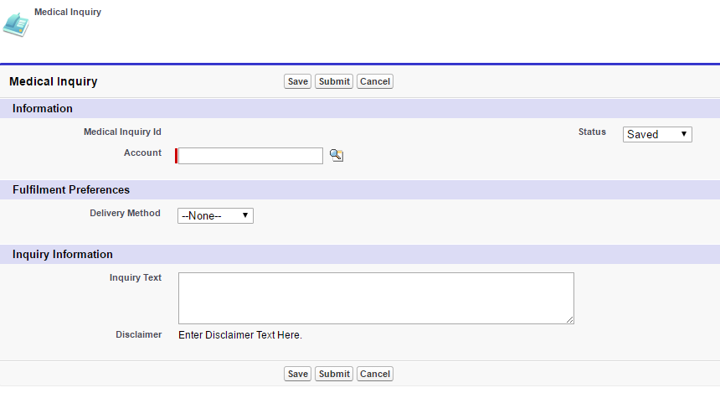
Components of Medical Inquiry ... 2
VEEVA CRM Medical Inquiry module helps user to selecting Delivery Details by fetching the Account information (such as address, phone number etc.) so that user can simply select it by select
Additionally, if account information is not available or user need to provide separate delivery details then user can choose to do so too
Additionally, VEEVA CRM provides a Product field if the inquiry is Product-specific and signature fields if an HCP signature is required to submit the inquiry
Account lookup
Delivery Method
Inquiry Text

Slide 12
Configuration of various components of Medical Inquiry module

Slide 13
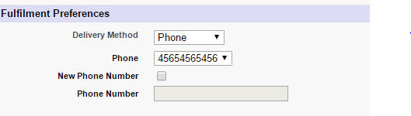
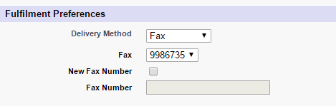
Configuring the Detail Page ... 1
Configuring Delivery Methods
  In order to use the out of the box delivery methods and delivery details, the field zvod_Delivery_Method_vod need to be placed on the Medical Inquiry page layout below the Delivery_Method_vod picklist
  The value selected in the Delivery_Method_vod picklist drives the details displayed to the user in the delivery details zvod field
  By default, after a delivery method is selected, the relevant delivery details picklist is displayed.
  However, section signals allow the user to enter new details as well
Users can select Phone number or Fax number which is already available in Account detail
Users can select this checkbox to enter new Phone Number or Fax Number
This field is used to capture the new Phone Number or Fax Number

Slide 14
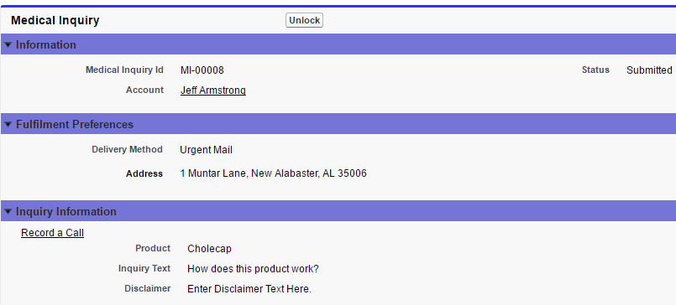
Configuring the Detail Page ... 2
Configuring Unlock Privileges
  Once a Medical Inquiry is submitted, the Lock_vod field is enabled and the record is no longer editable
  However, users with FLS edit permission to the Lock_vod field see an Unlock button when viewing a Medical Inquiry
  Selecting the Unlock button disables Lock_vod and changes the Status_vod field to Saved_vod

Slide 15
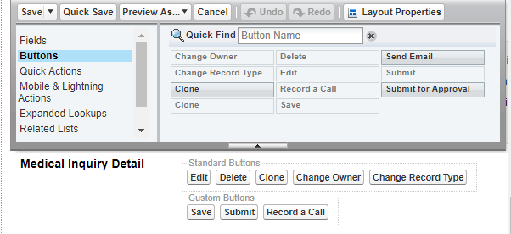
Configuring the Detail Page ... 3
Configuring Buttons on Page Layouts
  The Save, Submit, and Clone custom buttons are configurable for Medical Inquiries
  They can be added or removed from a user’s page layout to control availability to these functions
  To prevent a user from saving, submitting, or cloning Medical Inquiries, remove the Save_vod, Submit_vod, and clone_vod custom buttons from the page layout
  When using the Clone_vod button, the Signature_vod, Product, and Inquiry_Text_vod fields are not copied to the cloned record

Slide 16
Configuring the Detail Page ... 4
Configuring Section Signals
  Administrators can use various section signals in Medical Inquiries in order to control the behavior of the Medical Inquiry module
  The section signals used in Medical Inquiry module are in the below table
Section Signal | Use
--ana | Toggle between the Address picklist and an editable form for Address Line 1, Address Line 2, City, State, and Zip Code
--ane | Toggle between the email picklist and an entry form with the Email field
--anf | Toggle between the fax picklist and an entry form with the Fax Number field
--anp | Toggle between the phone picklist and a form with the Phone Number field
--eoe | To specify Email as an optional delivery method
--eof | To specify Fax as an optional delivery method
--eom | To specify Mail or Urgent Mail as an optional delivery method
--eop | Specify Phone as an optional delivery method

Slide 17
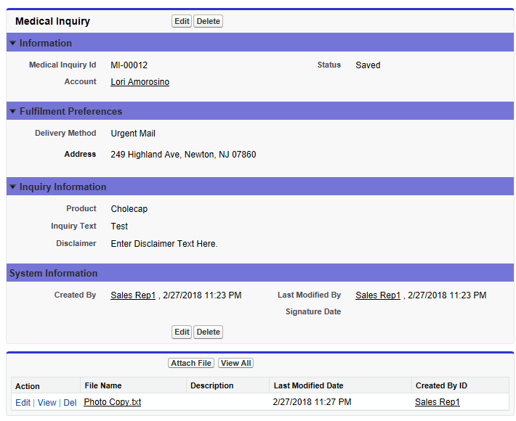
Displaying Medical Inquiry Attachments ... 1
VEEVA CRM allows users to create, edit, and view medical inquiry attachments from the Medical Inquiry screen
These attachments can then be viewed online by MSLs and other users
When users navigate to Medical Inquiries and selects Attachments then all attachments are displayed
Depending on the permissions provided to user they may modify the attachments on the Medical Inquiry

Slide 18
Displaying Medical Inquiry Attachments ... 2
Configuration
  Provide user necessary permissions on Medical Inquiry object
  Read permission is the minimum permission required to access this feature
  Place the Notes & Attachments related list on the appropriate Medical_Inquiry_vod page layout
Note:
  This feature is available on the Online platform
  This feature does not support Multiple Product Inquiries

Slide 19
Configuring the Signature Page ... 1
Configure Disclaimer Text
  DISCLAIMER_MI_vod VEEVA Setting is used to configure the Disclaimer Text
  The value of this setting need to be the name of the VEEVA Message used to store the default disclaimer text
  The default value of this setting is DISCLAIMER;;Medical_Inquiry
  Here DISCLAIMER is a VEEVA Message in Medical Inquiry category and the VEEVA Setting points to this VEEVA Message
  The disclaimer is limited to 1000 characters
  The Disclaimer Text shown to the account on the signature page in VEEVA is stamped into the Disclaimer_vod field when the record is saved

Slide 20
Configuring the Signature Page ... 2
Configuring Required Signatures
  The Sign button displays when the field Signature_Date_vod is placed on the page layout
  The signature itself is stored in a Base64 encoded string in the Signature_vod field
  The current date and time are stamped into the Signature_Date_vod field when the user accepts the signature
  Enabling the DISABLE_MI_SIGN_BUTTON_vod VEEVA Setting makes the Sign button disappear after a signature has been accepted
  This is used to prevent users from clearing a signature and changing Medical Inquiry details after an initial signature is captured

Slide 21
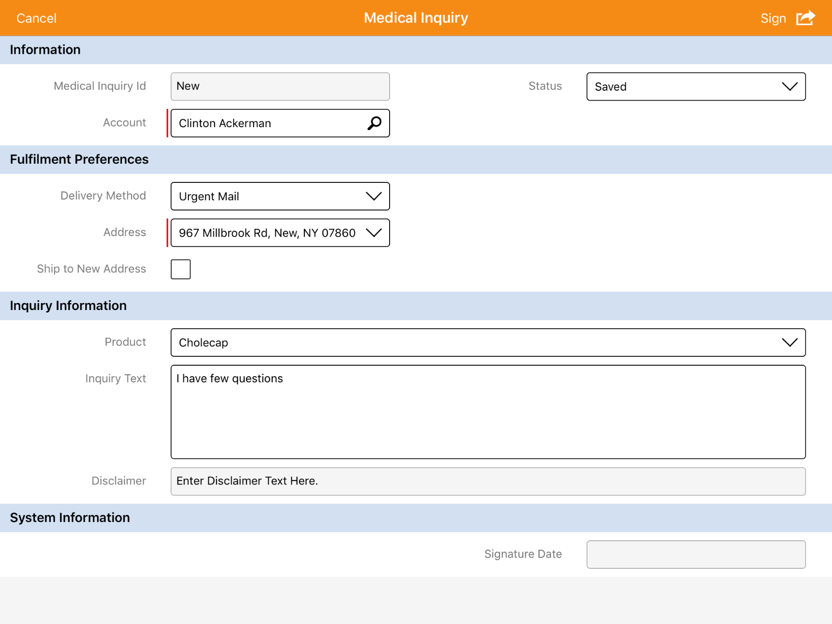
Configuring the Signature Page ... 3
User need to click on ‘Sign’ to capture HCP signature after all the information is filled
No signature has been captured yet for this medical inquiry

Slide 22
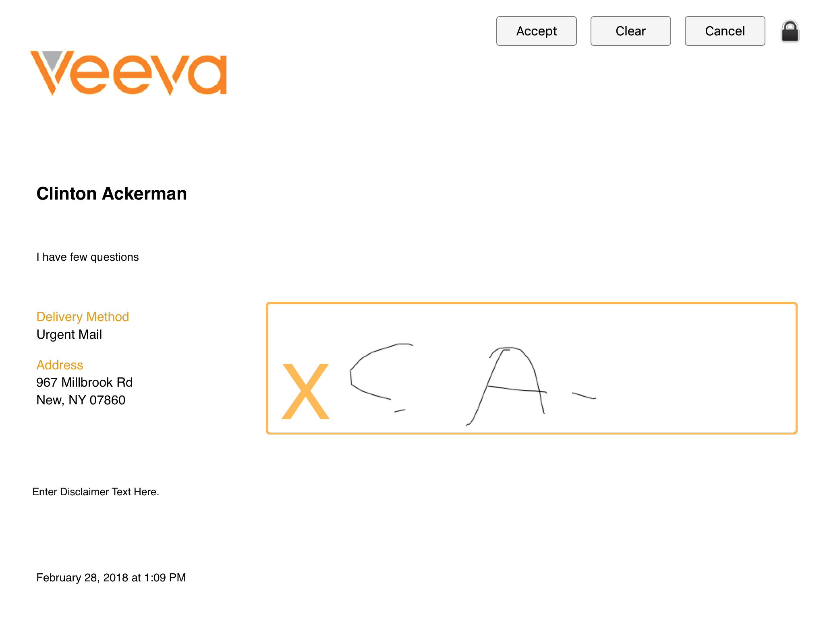
Configuring the Signature Page ... 4
Once the signature is provided, user need to click on ‘Accept’ button
1
HCP Name
3
HCP query
Delivery method and information
Disclaimer text
HCP signature
2
Current date time

Slide 23

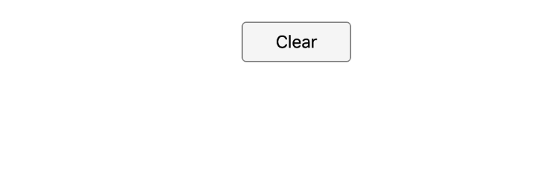
Configuring the Signature Page ... 5
Select the Lock icon to prevent HCPs from navigating back to CRM for iPad from the signature page
Selecting this button makes the Accept and Cancel buttons and the Lock icon invisible
Once signature is captured, the user selects the location of the invisible Lock icon to display the Accept and Cancel buttons
The user can then accept the signature by selecting the Accept button

Slide 24
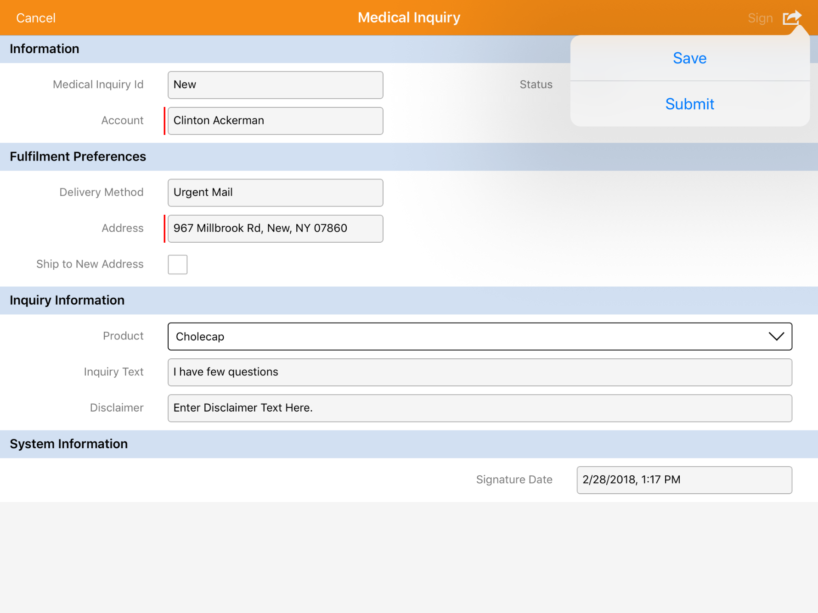
Configuring the Signature Page ... 6
‘Sign’ button is greyed out
User can now ‘Save’ or ‘Submit’ the inquiry
Signature is now captured

Slide 25
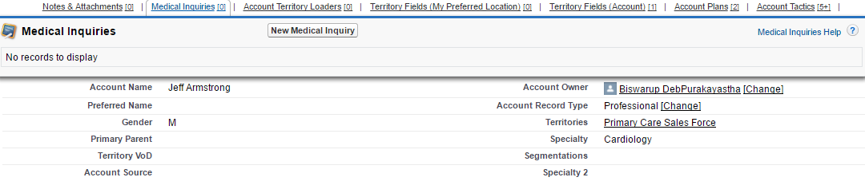
Configuring Medical Inquiry Creation ... 1
VEEVA CRM application allows users to create Medical Inquires in three ways: from an Account Related list, from a Call Report, and from CLM
Creating Inquiries from an Account Related List
  Medical Inquiries can be created from the Medical Inquiries related section on Account profile. To enable this feature follow the below steps:
    Place the Medical Inquiries related list on the Account page layout
    Enable the New button in related list properties

Slide 26
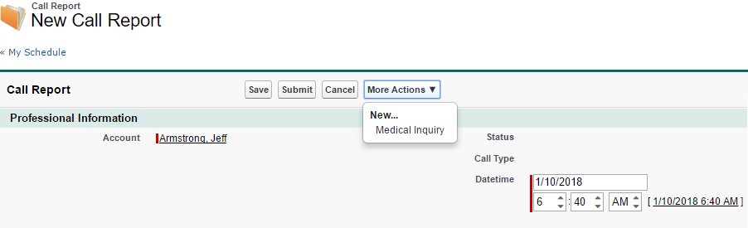
Configuring Medical Inquiry Creation ... 2
Creating Inquiries from a Call Report
  Users can create Medical Inquiries directly from a Call Report. When the user records a Call, the New Medical Inquiry option is available from the More Actions button on the Call Report
  To enable this feature please follow the below steps:
    Place the Medical Inquiries related list on the Account page layout
    Place the zvod_More_Actions_vod field on the Call page layout

Slide 27
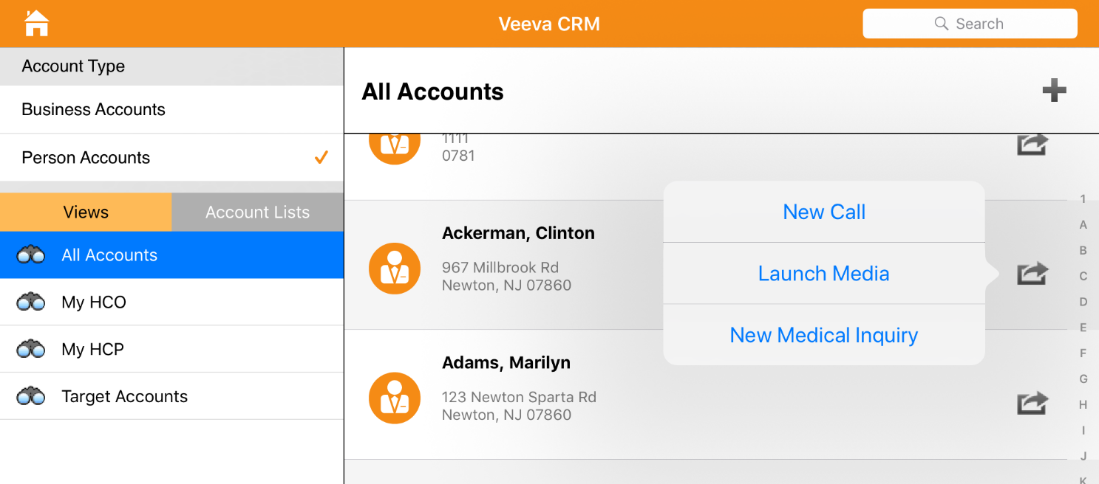
Configuring Medical Inquiry Creation ... 3
Creating Inquiries from My Account Views
  Users can create Medical Inquiries using the New_Medical_Inquiry_vod button from an Account profile, the Account Timeline, or the My Accounts list
  Users can only create Medical Inquiries from the Account Timeline if the Account Timeline is set as the default view
  In online application, users can create an Inquiry from the Account profile
  To configure creation of Medical Inquiries from My Accounts views enable the Medical_Inquiry_From_Account_vod and SObject_New_vod VisualForce pages for users and provide users with create permissions on the Medical_Inquiry_vod object

Slide 28
Configuring Medical Inquiry Creation ... 4
Creating Inquiries from CLM
  VEEVA CRM allows users to create a Medical Inquiry without exiting a CLM presentation.
  Users can create the Medical Inquiry by selecting the New Medical Inquiry option from the More Actions menu.
  When selected, a Medical Inquiry overlay displays.
  The overlay uses the same configuration as the standard Medical Inquiry page for buttons and behavior.
  After providing details for the Medical Inquiry and closing the overlay users return to their previous place in the CLM presentation.
  If the Medical Inquiry is not submitting till the end of the CLM Presentation, then it displays to the user for submission before the Call Report is displayed.
  To enable this functionality:
    Change the value of MEDICAL_INQUIRY_OVERLAY_vod Multichannel Setting to 1
    User is provided with create permissions to Medical Inquiry object

Slide 29
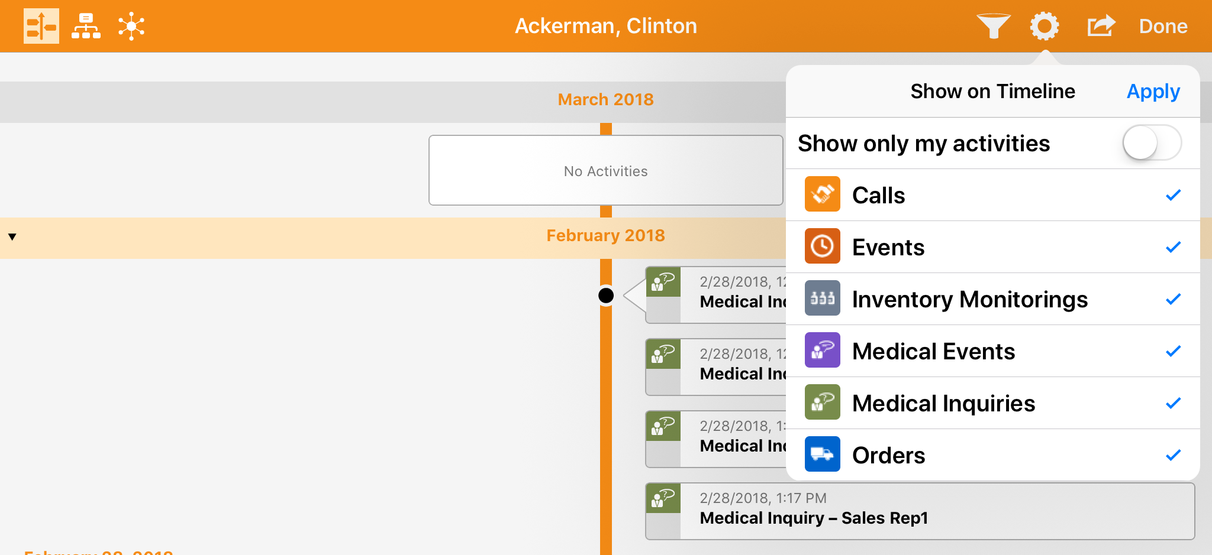
Configuring Medical Inquiry Creation ... 5
Once the medical inquiry is created user can see the record from account detail page, and also from timeline

Slide 30
Configuration of Medical Inquiry module for multiple Product inquiries

Slide 31
Configuring Multiple Product Inquiries ... 1
Medical Inquiry feature in VEEVA CRM application by default allows users to capture a single inquiry at a time
However, it is possible to capture multiple Medical Inquiries at once even if they are for different products
This feature allows capturing multiple Medical Inquiries from a single page and a HCP can view all captured Medical Inquiries on a single Signature screen
When using this feature, a new Medical Inquiry record is created for each sibling Medical Inquiry
These records are linked together using the Group_Identifier_vod field

Slide 32
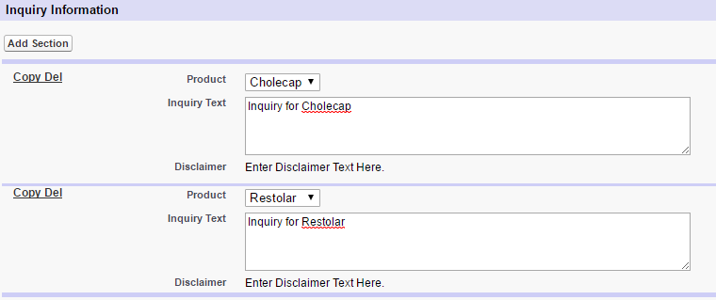
Configuring Multiple Product Inquiries ... 2
To enable this feature, the below steps need to be performed:
  Provide Edit FLS permission of Group_Identifier_vod field on the Medical_Inquiry_vod object to users
  Add section signal –mpi in the relevant page layout section in a Medical Inquiry. All fields inside this section may contain different values in sibling records while fields outside this section will contain the same value for all sibling records

Slide 33
Configuring Signature Audit
Medical Inquiry signatures can be viewed and printed from the related list on an Account page
To enable this feature, the View Signatures button needs to be placed in the Medical Inquiry related list in Account page layout
Clicking this button loads a table of the 50 most recent signatures, with the newest signatures displaying first
To order to view/audit signatures captured by the user for Medical Inquiries, View Medical Inquiry Signatures button on Rep Roster page can be used

Slide 34
Configuring Print Receipts
VEEVA CRM allows generating PDF receipts for printed Medical Inquiry records
Adding the Print Receipt custom button on Medical Inquiry related list on the account page layout enables this feature
RECEIPT_TEMPLATE VEEVA Message in the Medical_Inquiry category is used to define an HTML template for the PDF
In the application, users can scroll to the Medical Inquiries related list on the Account profile page, select the check box for a Medical Inquiry, and click the Print Receipts button
On doing so user is navigated to a custom page with an embedded PDF following the defined template and user can print it from there

Slide 35
Create Calls from Medical Inquiry ... 1
Sometimes MSL users are required to respond to a Medical Inquiry in person
Using VEEVA CRM, MSL users can create a Call from a Medical Inquiry for follow-up activities
In order to enable this feature please follow the below 2 steps:
  Place the Record_a_Call_vod custom button on the Medical_Inquiry_vod page layout
  Provide users with Edit FLS permission for Medical_Inquiry_vod field on the Call object
Note:
  This feature is available on both Online and iRep platforms
  The Record a Call button is only available on submitted Medical Inquiries with an SFDC ID

Slide 36
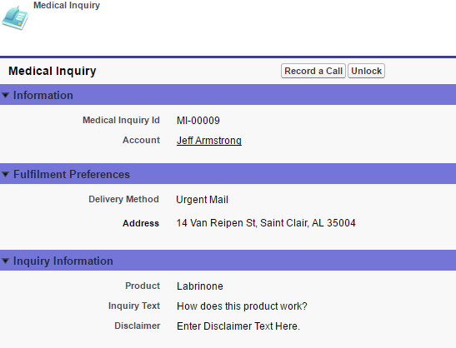
Create Calls from Medical Inquiry ... 2
Record A Call from a Medical Inquiry for a Single Product
Record A Call from a Medical Inquiry for a Multiple Products

Slide 37
Medical Inquiries VEEVA Settings
The various VEEVA Settings used to configure the Medical Inquiry module are listed in below table
VEEVA Setting | Type | Setting Description
Auto_Sync_vod | Number | It activates the auto-sync of submitted call data. The value is defined in Number of minutes upon which the auto-sync routine will be invoked
Disable_MI_Sign_Button_vod | Check box | TRUE value disable the sign button on a medical inquiry page after a signature. FALSE enables
Disclaimer_MI_vod | Text | String used by application. Default is: Enter Disclaimer Text Here
Receipt_Template_vod | Text | This is the html template used to print a medical inquiry receipt

Slide 38
Check Your Understanding ... 1
1. Arrange the following steps in Medical Inquiry Life Cycle:
I. Capturing a Signature
II. Submitting an Inquiry
III. Creating a Medical Inquiry
IV. Processing Submitted Inquiries
I → II → III → IV
I → III → II → IV
II → IV → I → III
III → I → II → IV
Answer: III → I → II → IV
© Cognizant 2015

Slide 39
Check Your Understanding ... 2
2. Which VEEVA Setting is used to configure the Disclaimer Text?
DISCLAIMER_TEXT_vod
DISCLAIMER_MI_vod
Disable_MI_Sign_Button_vod
None of the above
Answer: DISCLAIMER_MI_vod
© Cognizant 2015

Slide 40
Check Your Understanding ... 3
3. VEEVA CRM allows users to create, edit, and view medical inquiry attachments from the Medical Inquiry screen.
State True or False
True
False
Answer: True
© Cognizant 2015

Slide 41
Check Your Understanding ... 4
4. Which section signal is used to enable configuring Medical Inquiries for multiple products?
-mpi
-anp
-mpr
-eom
Answer: -mpi
© Cognizant 2015

Slide 42
Check Your Understanding ... 5
5. An HTML template for the PDF can be defined by editing the _____ VEEVA Message in the Medical_Inquiry category.
INQUIRY_RECORD
RECEIPT_RECORD
INQUIRY_TEMPLATE
RECEIPT_TEMPLATE
Answer: RECEIPT_TEMPLATE
© Cognizant 2015

Slide 43

Summary
In this module, you have learnt to:
  Describe Medical Inquiries life cycle
  Define the components of Medical Inquiry
  Configure various components of Medical Inquiry module
  Configure Medical Inquiry module for multiple Product inquiries

Slide 44

Source
https://crmhelp.VEEVA.com/doc/Content/Home.htm
https://trailhead.salesforce.com/en/home
Disclaimer: Parts of the content of this course is based on the materials available from the Web sites and books listed above. The materials that can be accessed from linked sites are not maintained by Cognizant Academy and we are not responsible for the contents thereof. All trademarks, service marks, and trade names in this course are the marks of the respective owner(s).

Slide 45
Coming Next ...
In the upcoming module - Call Management Configuration, you will learn about:
  Call Data Model
  Marker Fields and Section Signals
  Call page layout sections including:
      Call Attendees
      Product Details
      Key Messages
      Pre and Post Call Notes
  Configuration of call page layout assignment
  Restrict and default Call types by Account record types
© Cognizant 2015
45

Slide 46
Thank You!
  You have successfully completed
  VEEVA Medical Inquiries

